Slide 1
The history of videogames
Kraev Stepan & Serebryakov Grigoriy
ИУ9-21Б

Slide 2
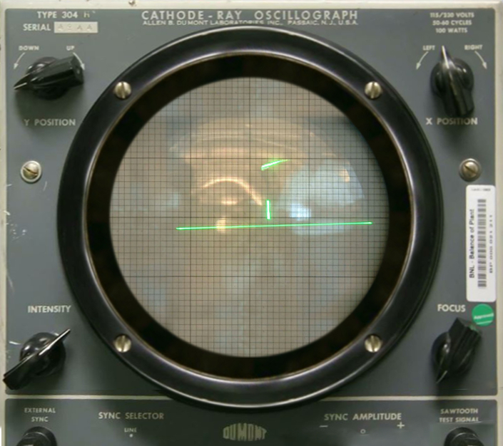
1950 – 1970 – Tinkering
The history of video games is closely linked to the evolution of the computer. In the 1950s, huge, room-sized computers solved relatively simple arithmetical problems. However, these inventions were intended not for entertainment, but rather to demonstrate how the new technology worked. Tennis for Two, appearing in 1958, was the first video game programmed purely for entertainment. The game, consisting of a monitor for a piece of equipment on which two people were able to bat a spot of light back and forth

Slide 3
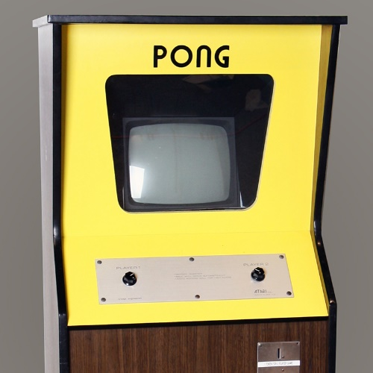
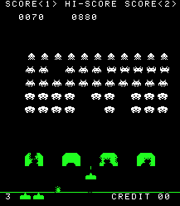
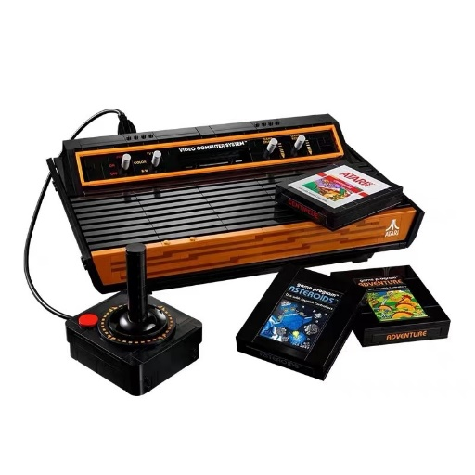
1970s – Birth of the video game machines
In 1972, the firm Atari was founded. The company not only dominated the video game industry for the next decade – it also developed Pong, the first game to become a global success. The playing principle of Pong is very similar to that of its predecessor, Tennis for Two, and could not have been easier. Although the idea for the game was not new, Atari integrated the computer, together with a display screen, into a box with a coin slot – thus inventing the video game machine.
The game Space Invaders (1978) heralded the beginning of the golden age of the arcades, where the teenagers of the 1980s gambled away their pocket money on video game machines.
And Atari succeeded in pulling off another coup with the Atari 2600 home console, which wasn’t restricted to just a single game but, thanks to interchangeable cassettes, offered a theoretically infinite number of games.

Slide 4



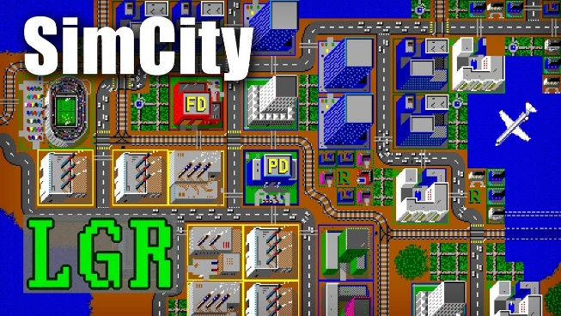
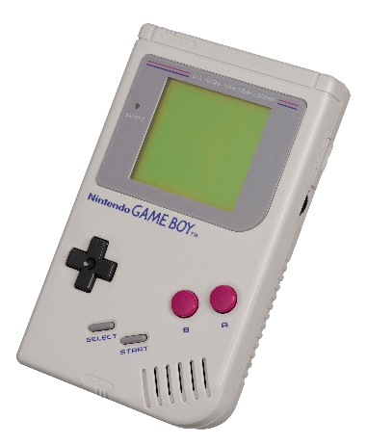
1980s – The infancy of video games
Many classic games that are still going strong today came out in the 1980s: Pac-Man (1980), Ultima (1980), Mario Bros (1983), Tetris (1984) and SimCity (1989).
Games got their own characters and more complex stories. Most genres as we know them today have their origins in this period. The Commodore 64 even allowed highly motivated users to program their own games. Children and teenagers of the 1980s spent hours in front of their home computers or consoles, and with the release of the Game Boy at the end of the decade, they even carried on after lights-out

Slide 5


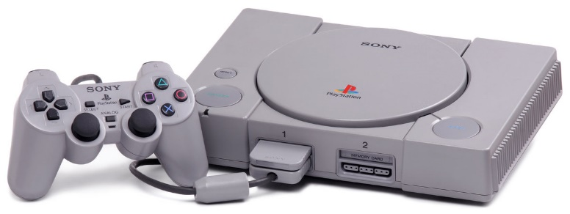
1990s – A new dimension
Video games entered a new dimension – literally, because in the second half of the decade the graphics became three-dimensional. In 1994, Sony launched the PlayStation – in technical and graphic terms, it was a quantum leap compared to the existing consoles.
The game design studios churned out more innovative ideas, with history often serving as inspiration for the gameplay: in Age of Empires (1997), gamers built entire civilisations, and in Command & Conquer (1995) they waged war. In Tomb Raider (1996) they searched for historical artefacts alongside Lara Croft; in Monkey Island (1990), it was pirate’s treasure they were after
Starting with Wolfenstein 3D (1992), ‘first-person shooters’ emerged. In these games, a player uses a weapon to kill off his or her opponents from a first-person perspective.

Slide 6


2000s – Gaming goes online
Powerful graphics technologies made the video game worlds even more realistic. Thanks to artificial intelligence, simulated opponents no longer behave the same way in every situation, instead reacting autonomously to what’s going on in the game. Open-world games were introduced, in which players explore fictional worlds on their own and are able to freely determine the course of the game. Or they create the virtual world themselves, as in a sandpit: this gaming concept is called ‘sandbox’.
At the beginning of the millennium, the internet was still not powerful enough or in sufficiently widespread use to enable people to play against one another online. So gamers got together at LAN parties. Players brought their own computers and connected them up in a local network in order to play against one another into the early hours, or even all night long. Especially popular at these parties was the sometimes controversial game Counter-Strike (2000), in which gamers take on the role of terrorists or members of an anti-terror unit and use tactical manoeuvres to try to eliminate each other. But then, with the phenomenal increase in internet use, gaming also went online. For the first time games, such as World of Warcraft (2004), were played mainly on the internet.

Slide 7



2010s – Play anywhere, anytime
Games such as Red Dead Redemption 2 (2019) which, thanks to sophisticated dialogues and emotive storylines, not only provide hours of gaming fun but also take a different course according to the player’s decisions, and so can be played again and again, are put out on PCs, PlayStation and Xbox. Another phenomenon of this decade is what are known as ‘Let’s play’ videos. Gamers record themselves playing a game, providing a commentary on the gameplay as it unfolds and giving tips, and then post the video on YouTube

Slide 8
Thank you for watching

